Slide 1
Arcade Game Project:
PenPenPenguin
Team 2-10 : Jingwen Wu & Haoxuan Sun

Slide 2
Design Goal
Functionality
Usability
Artistic
Notes:
Functionality: code can work with all function designed
Usability: We have clear labels and instructions to
Artistic : fancy images and animations

Slide 3
Extra Feature
Overview
1. Animation of characters (with directions)
2. Start page with animation and game instructions
3. End page showing highest score
4. Status bar indicating passed time, hero’s lives and number of collected diamonds .
5. Sound effects and background music
6. Hero can shoot: bullets only hurting enemy
7. An boss level is added after normal level

Slide 4
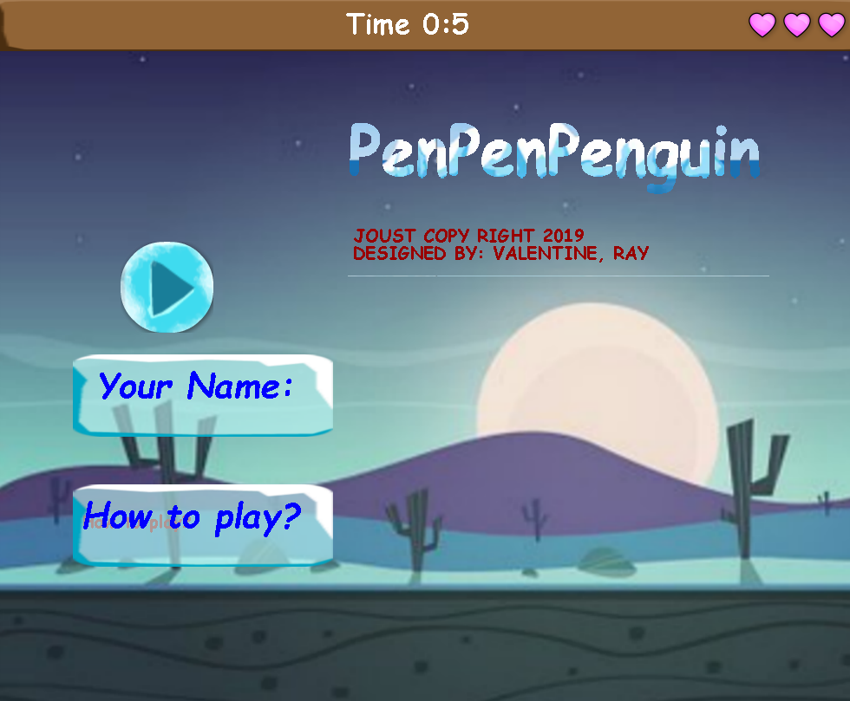
Start Page

Slide 5
Design Decision:
Design Decision:
The process to draw images of elements
Load image and set image on game levels
Cool Animations

Slide 6
Process to Draw Elements’ Images
Interface--getImage()
Element---load image
GameComponent--get drawable parts—g2.drawImage
public interface Drawable {
Shape getShape();
Color getColor();
Image getImage();
}
try {
this.image = ImageIO.read(new File("flake.png"));
} catch (IOException e) {
throw new RuntimeException("Could not load image file ");
}
public synchronized ArrayList<Drawable> getDrawableParts() {
ArrayList<Drawable> thingsToDraw = new ArrayList<Drawable>();
for (Wall w : this.walls) {
thingsToDraw.add(w);
}}

Slide 7









Images & Animation
Hero
Monster
Ice ball
Brick
Fire ball
EXP

Slide 8
Put Image on GameLevel
Process:
Load Image
g2.drawImage
try {
this.startPage = ImageIO.read(new File("background2.png"));
} catch (IOException e) {
throw new RuntimeException("Could not load image file ");
}
g2.drawImage(this.startPage, 0, 0, null);

Slide 9
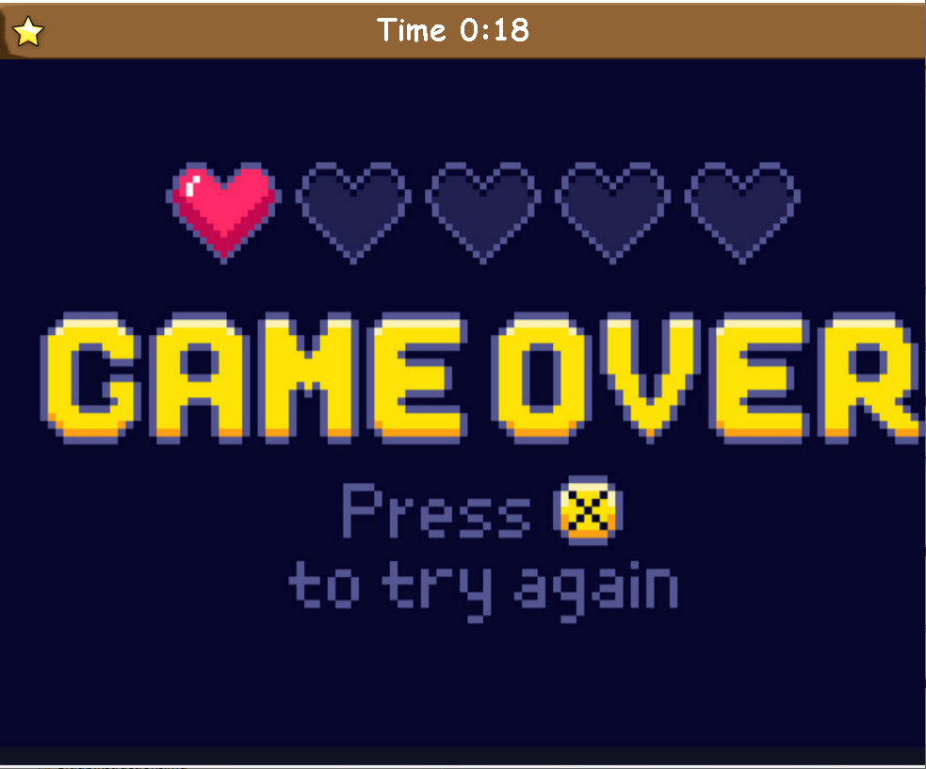
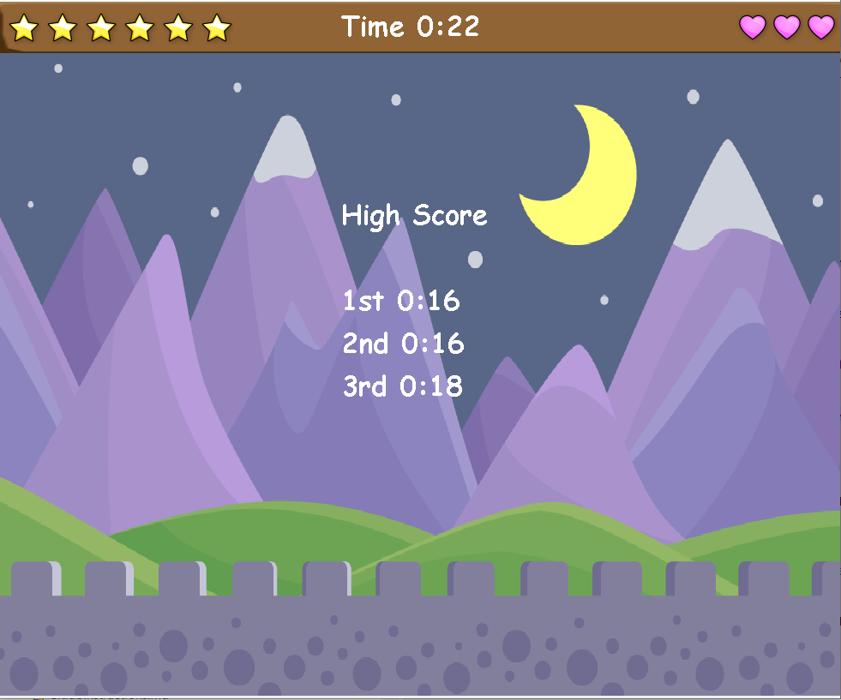
Status Bar & End Page
EXP Level
Passed Time
Life Bar

Slide 10

Animations
List of Animations:
Different position when hero is moving
Swing of monsters’ feet
Draw a moving image on the a word

Slide 11
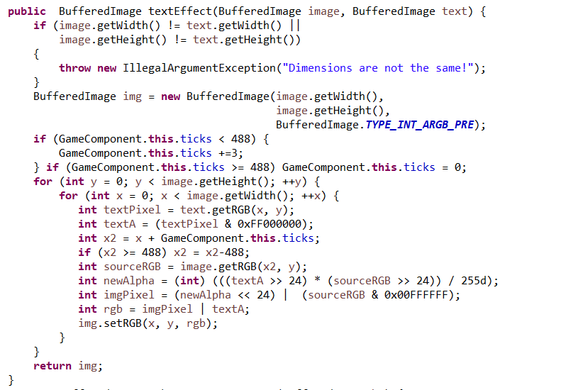
Images & Animation
this.acceleration += 0.1;
if (this.walk_count == 2) {
this.image = this.walk_left_1;
}
if (this.walk_count == 10) {
this.image = this.walk_left_2;
}
if (this.walk_count == 20) {
this.image = this.walk_left_3;
}
if (this.walk_count == 30) {
this.image = this.walk_left_4;
this.walk_count = 1;
}
this.walk_count ++;

Slide 12
Conclusion
Implement OO design principles
Skill of debug
Team work

Slide 13
Reference
URL:
http://www.aigei.com/s?q=%E5%B0%84%E5%87%BB&type=sound

